Slide 1

SMART TRAFFIC SIGNAL MANAGEMENT USING AI
PRESENTED BY
Saniya sajan
Sneha maria m s
Sreyas raj p
VIVEK VISWANaTHAN
GUIDED BY
Dr. SOOSAN GEORGE T Dr. ANJU PRATHAP
PROFESSOR AND DEAN PROFESSOR AND HOD
CIVIL ENGINEERING DEPARTMENT CS ENGINEERING DEPARTMENT

Slide 2

CONTENTS
INTRODUCTION
LITERATURE REVIEW
LITERATURE SUMMARY
OBJECTIVES
METHODOLOGY
WORK SCHEDULE
PROGRESS OF WORK
RESOURCES REQUIRED
CHALLENGES
REFERENCES

Slide 3
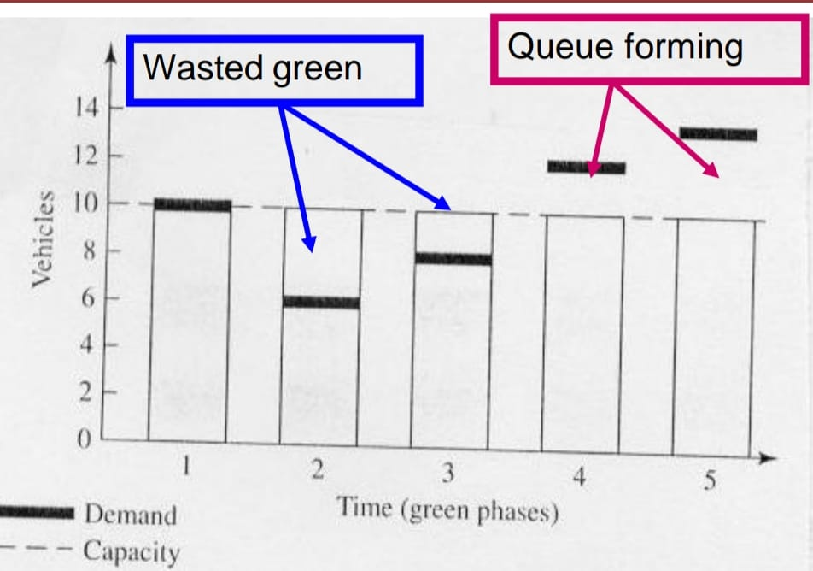
INTRODUCTION
Conventional traffic control methods- fixed signal timers at intersection
Manual control system- require significant manpower
Fixed phase traffic lights don’t adapt to real time traffic conditions
Demand varies- green time is wasted or queue is formed

Slide 4
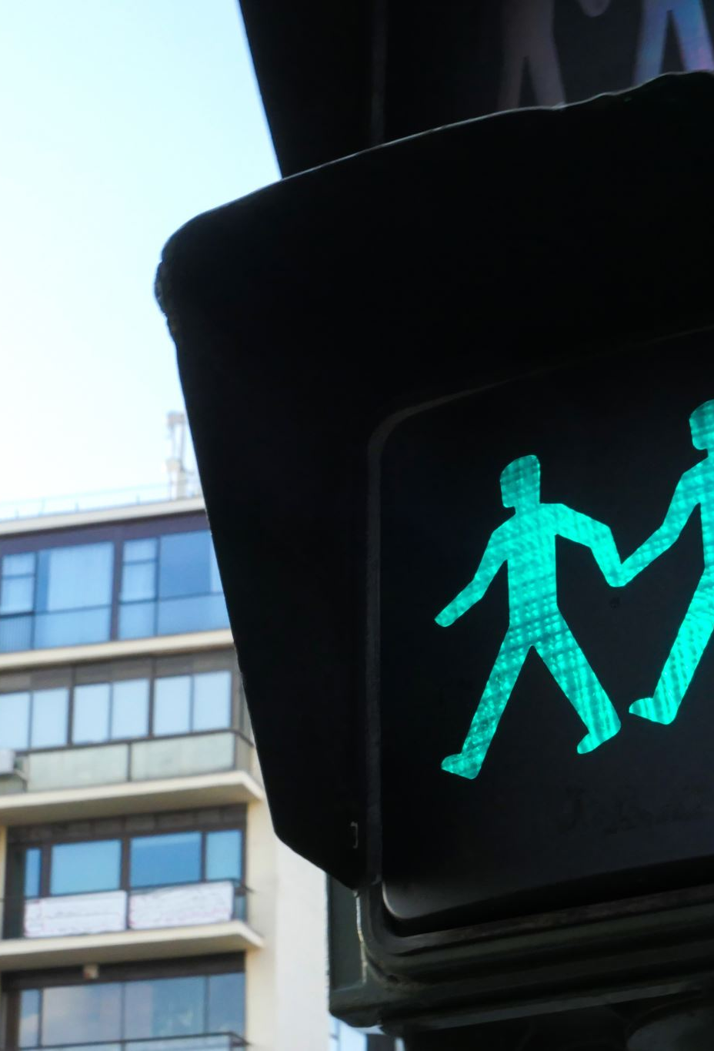
INTRODUCTION
A dynamic road traffic signal control system using artificial intelligence
Traffic flow optimised by adjusting signal timings based on real-time traffic data
CCTV cameras – vehicle detection
YOLO- You Only Look Once algorithm for setting green signal timer for each lane
Lower unwanted delays, reduce congestion and waiting time

Slide 5
LITERATURE REVIEW
Sl No. | Authors | Journal | Paper Title | Year | Remark
1 | Mandal et al. | Sustainability | Artificial Intelligence enabled Traffic Monitoring system | 2020 | This paper introduces an innovative method for automating real time traffic surveillance system using deep learning models and extensive video data.
2 | Mimansha et al. | e-Prime- Advances in Electrical Engineering, Electronics and Energy | Real-time traffic control and monitoring | 2023 | Utilized real time video feeds from camera for vehicle detection using EfficientDet Architecture and Tensorflow lite

Slide 6
Sl No.​ | Authors​ | Journal​ | Paper Title​ | Year​ | Remark​
3​ | Kanungo et al. ​ | Recent Advances in Engineering and computational sciences​ | Smart Traffic lights switching and traffic density calculation using video processing​ | 2014​ | Utilized SVM and image processing via OpenCV to analyse live video frames in small segments​
4​ | Chung and Sohn​ | IEEE Transactions on Intelligent Transportation systems​ | Real-time traffic control and monitoring​ ​ | 2023​ | Utilized real time video feeds from camera for vehicle detection using EfficientDet Architecture and Tensorflow lite​
5​ | Chakraborthy et al.​ | Transportation Research Record​ | Traffic congestion detection from camera images using deep convolutional neural networks​ | 2018​ | Used traffic imagery and applied both DCNN and YOLO algorithms in different setups​

Slide 7
Sl No.​ | Authors​ | Journal​ | Paper Title​ | Year​ | Remark​
6 | Engulund et.al | Smart cities | AI perspective in smart cities and communities to enable road vehicle automation and smart traffic control | 2021​ | Utilized AI perspective inSCC and enable road vehicle automation and smart traffic control
7 | Modi et.al​ | Innovative infrastructure solution | A comprehensive review on intelligent traffic management using machine learning algorithms ​ | 2021 | Utilized AI enabled traffic management system provide greater leeway to vehicle

Slide 8
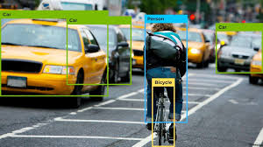
LITERATURE SUMMARY
These papers present a unique approach to deep learning models and large amounts of video data-driven automation of a real-time traffic monitoring system
Real-time video feeds from cameras using tools like YOLO, Tensorflow lite, EfficientDet Architecture
Out of these YOLO seems to be the most accurate and faster tool

Slide 9

objectives
To enhance traffic management and reduce congestion by dynamically adjusting signal timings based on real-time traffic conditions.
To improve overall road safety by utilizing AI algorithms to detect and respond to potential traffic violations.
To optimize fuel efficiency and reduce carbon emissions by minimizing the time vehicles spend idling at intersections.
To enhance emergency response times by prioritizing the flow of emergency vehicles through traffic signals, ensuring they reach their destinations quickly and efficiently.

Slide 10
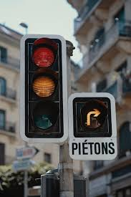
Working of traffic signal in real time
Cameras capture videos
Update Traffic signal timer
Vehicles detected by image processing
Calculating traffic density
Setting green signal time

Slide 11
METHODOLOGY
Dataset Collection for algorithm (Videos)
Creating a simulation using pygame
Site Selection
Traffic Volume
survey
Dataset collection for Training YOLO
(Images)
Creating a prototype working with Arduino

Slide 12
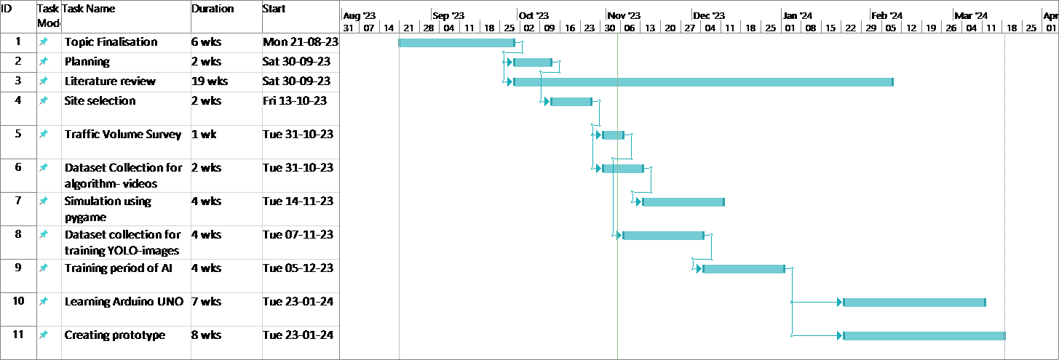
Work schedule

Slide 13
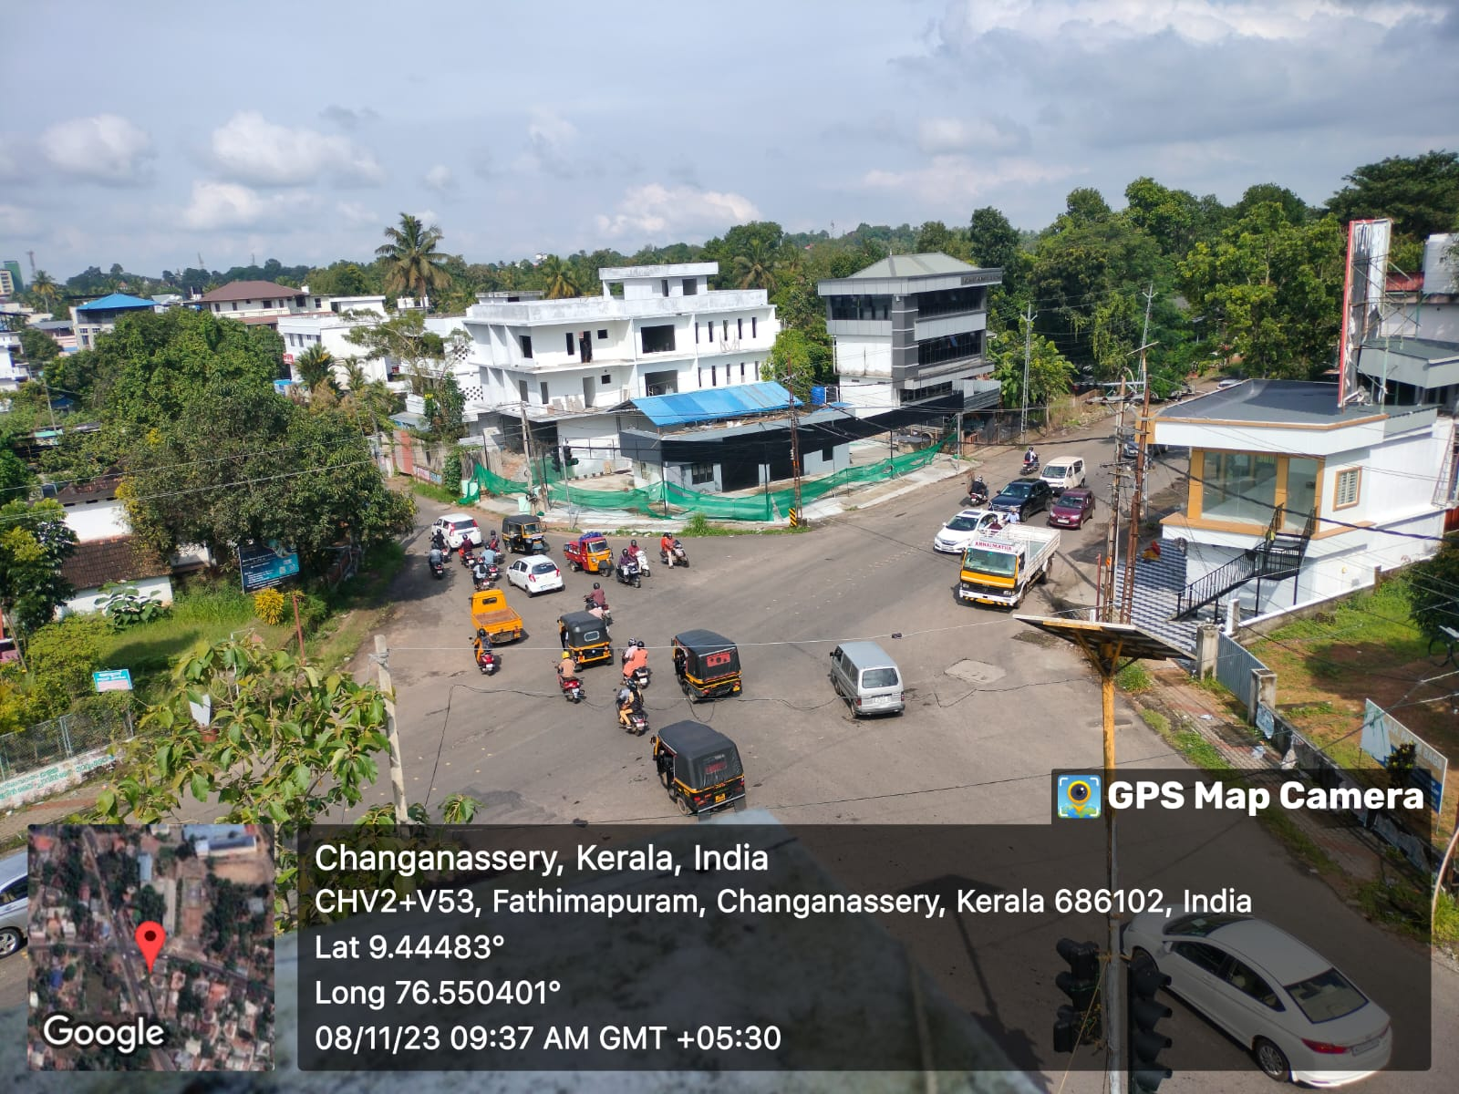
WORK PROGRESS
Referred Journals
Finalised Methodology
Selected site - SH junction, Changanassery
Took traffic volume survey
Identified peak hours by converting into PCU
Started dataset collection for simulation by capturing videos

Slide 14
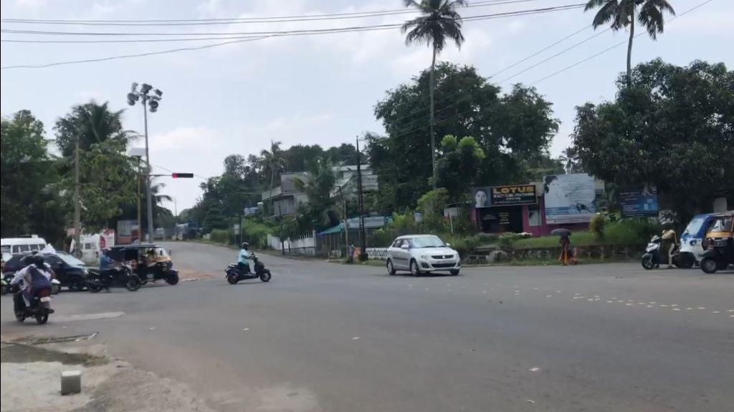
SH junction, Changanassery

Slide 15
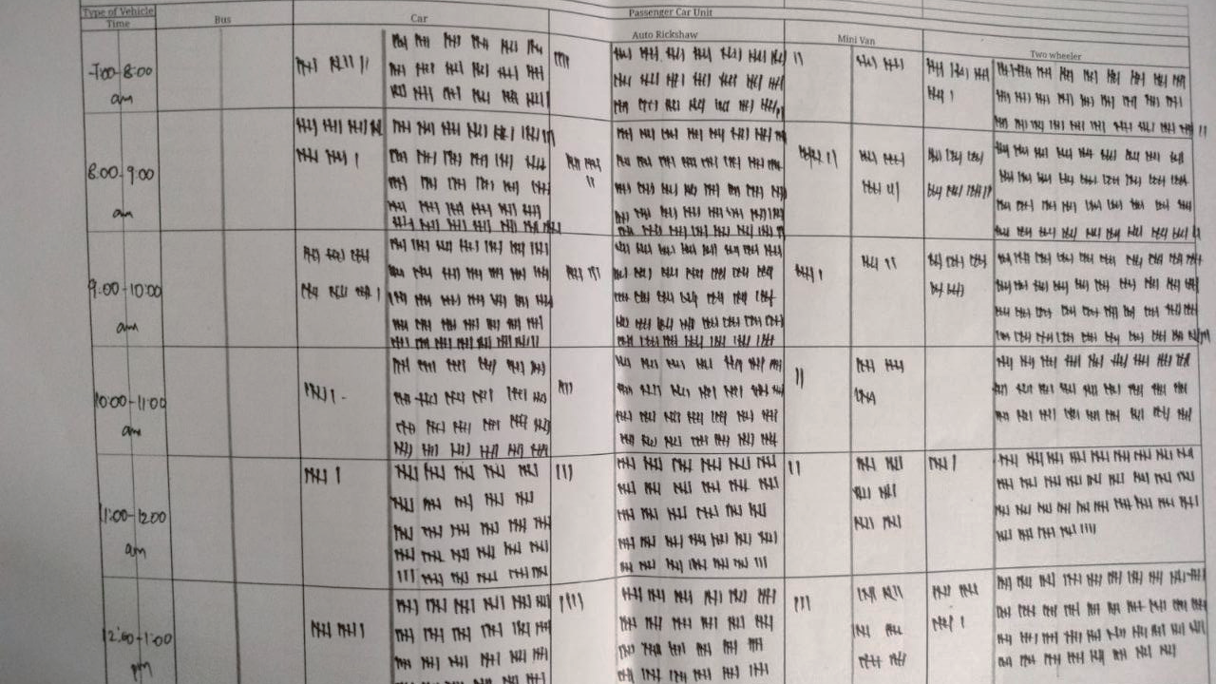
TRAFFIC VOLUME COUNT

Slide 16
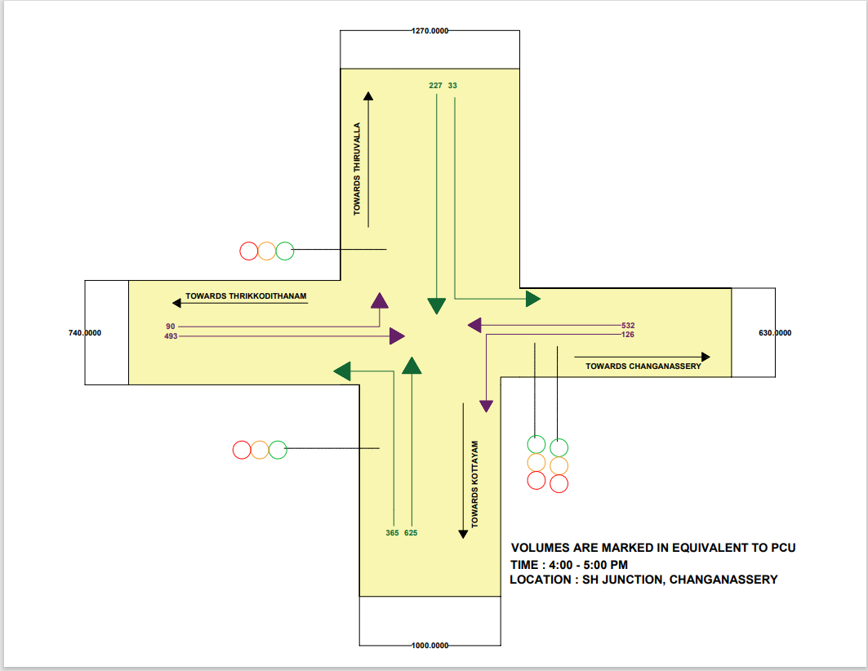

Slide 17
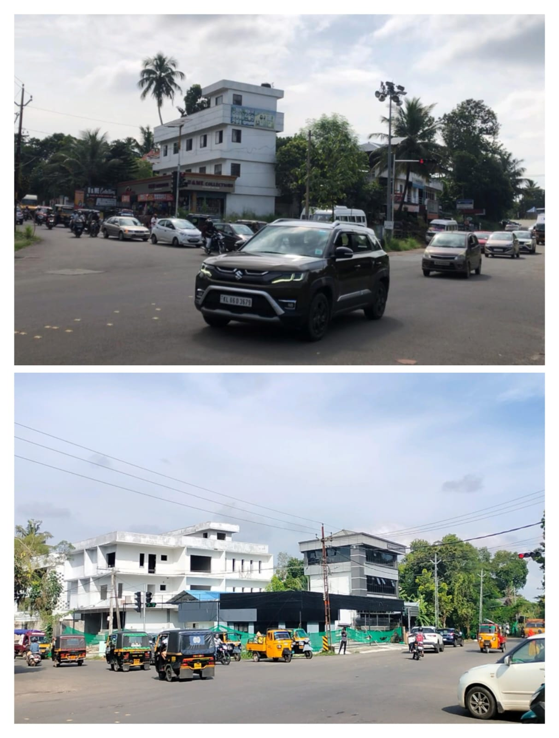
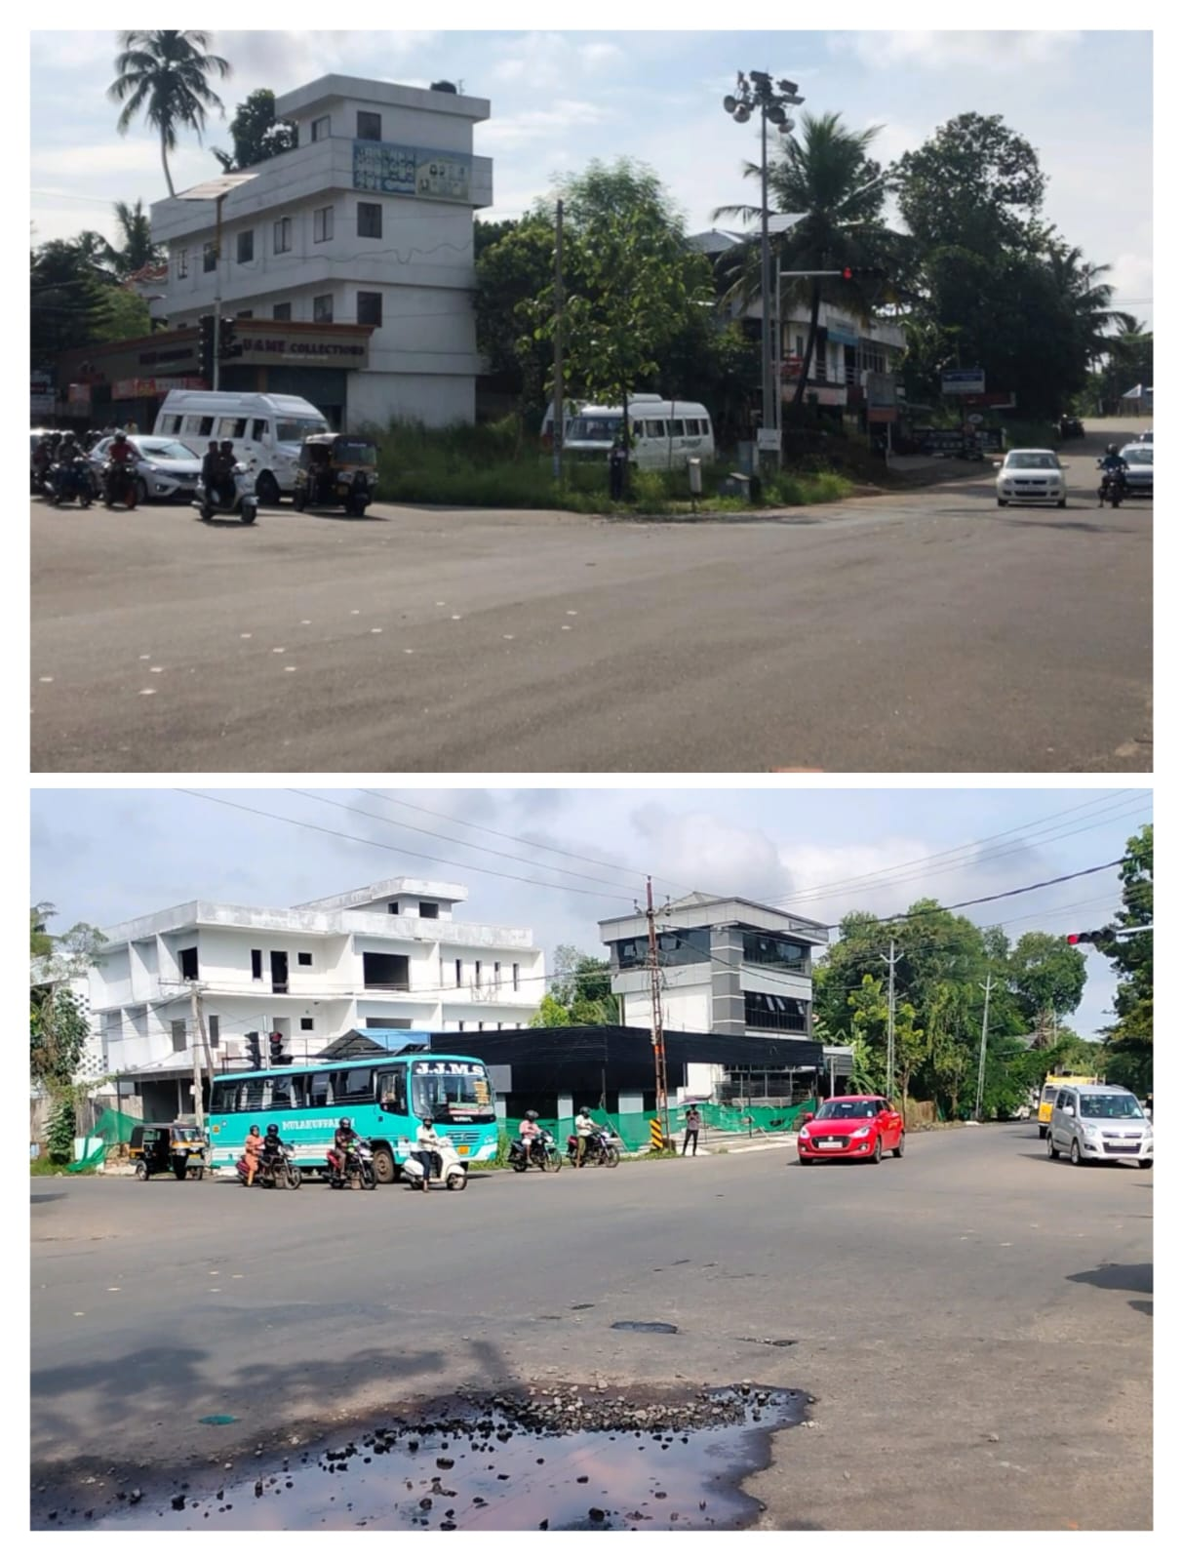
PEAK HOURS NON PEAK HOURS
STARTED COLLECTING VIDEOS FOR TABULATING REQUIRED DATA FOR SIMULATION

Slide 18
TABULATION OF COLLECTED DATA
DIRECTION | No of vehicles waiting at RED | No of vehicles passing at GREEN | Remaining vehicles | Wasted green time
FROM THIRUVALLA | 13 | 13 | - | 7.6
FROM THRIKKODITHANAM | 45 | 40 | 5 | -
FROM KOTTAYAM | 13.2 | 13.2 | - | 2
FROM CHANGANASSERY | 15.2 | 15.2 | - | 10

Slide 19
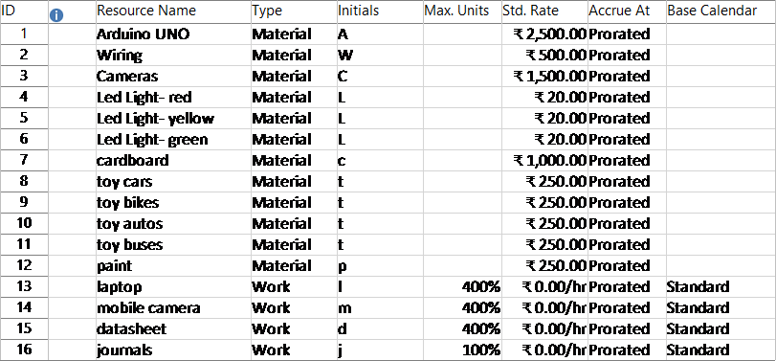
Resources required

Slide 20
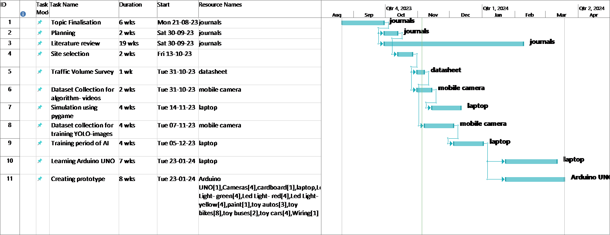
Resource ALLOCATION

Slide 21
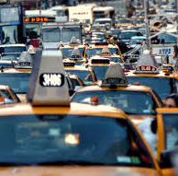
CHALLENGES
Developing efficient AI algorithms to process real-time traffic data and make decisions within milliseconds
Integrating various data sources (e.g., cameras, sensors, GPS) while ensuring data accuracy and reliability
Creating AI models that can adapt to rapidly changing traffic conditions, such as accidents, road closures, and unexpected events
Implementing robust privacy measures to protect sensitive information gathered by smart traffic systems and safeguarding against cyber threats

Slide 22
REFERENCES
Vishal,M., Abdul R,M., jin,P., Adu-Gyamfi,Y, 2020 , “Artificial Intelligence enabled Traffic Monitoring system", Sustainability, https://doi.org/10.3390/su12219177
Gupta,M., Miglania,H., Deo,P., Barhatte,A, 2023, “Real-time traffic control and monitoring”, e-Prime- Advances in Electrical Engineering, Electronics and Energy, https://doi.org/10.1016/j.prime.2023.100211
Kanungo., Sharma,A., Singla,C, 2014, “Smart Traffic lights switching and traffic density calculation using video processing”, Recent Advances in Engineering and computational sciences, https://doi.org/10.1109/RAECS.2014.6799542
Chung., Sohn, 2023, “Real-time traffic control and monitoring​”, IEEE Transactions on Intelligent Transportation systems, https://doi.org/10.1016/j.prime.2023.100211

Slide 23
REFERENCES
5. Englund,C., Aksoy,EE., Fernandez,FA., Cooney,MD,2021,”AI perspective in smart cities and communities to enable road vehicle automation and smart traffic control”.,Smart cities https://doi.org/10.3390/smartcities4020040
6. Yash Modi,Ridam Teli,Akshat Metha,Konark Shah,Manan Shah,(2021),” A comprehensive review on intelligent traffic management using machine learning algorithms”, Innovative infrastructure solution, https://link.springer.com/article/10.1007/s41062-021-00718-3
7. Chakraborthy,P., Okeryere,Y., Gyamif,A., Sankar,S, 2018,” Traffic congestion detection from camera images using deep convolutional neural networks”, Transportation Research Record, https://doi/abs/10.1177/036119811877763

Slide 24

THANK YOU

